Slide 1
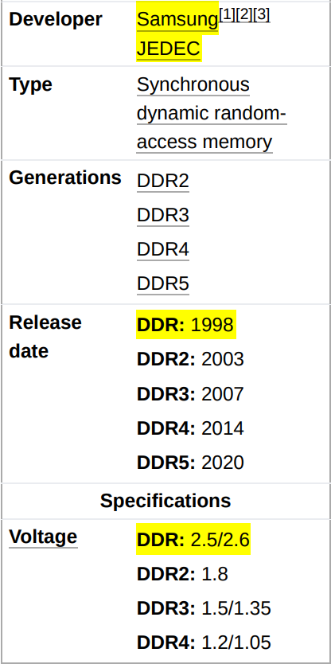
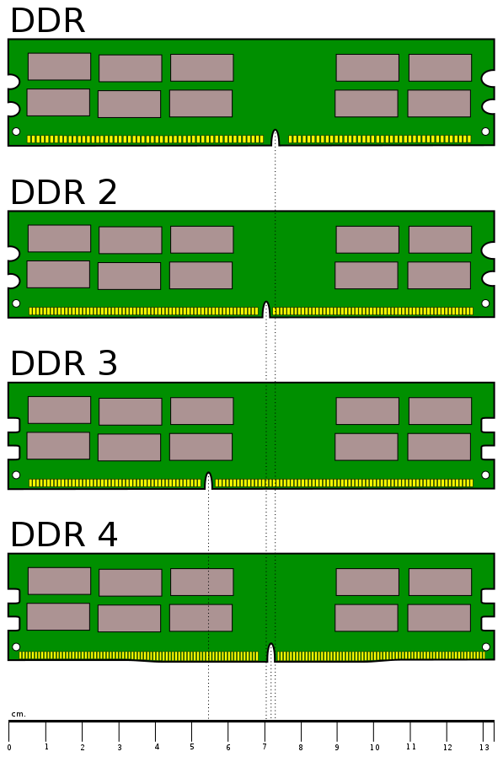
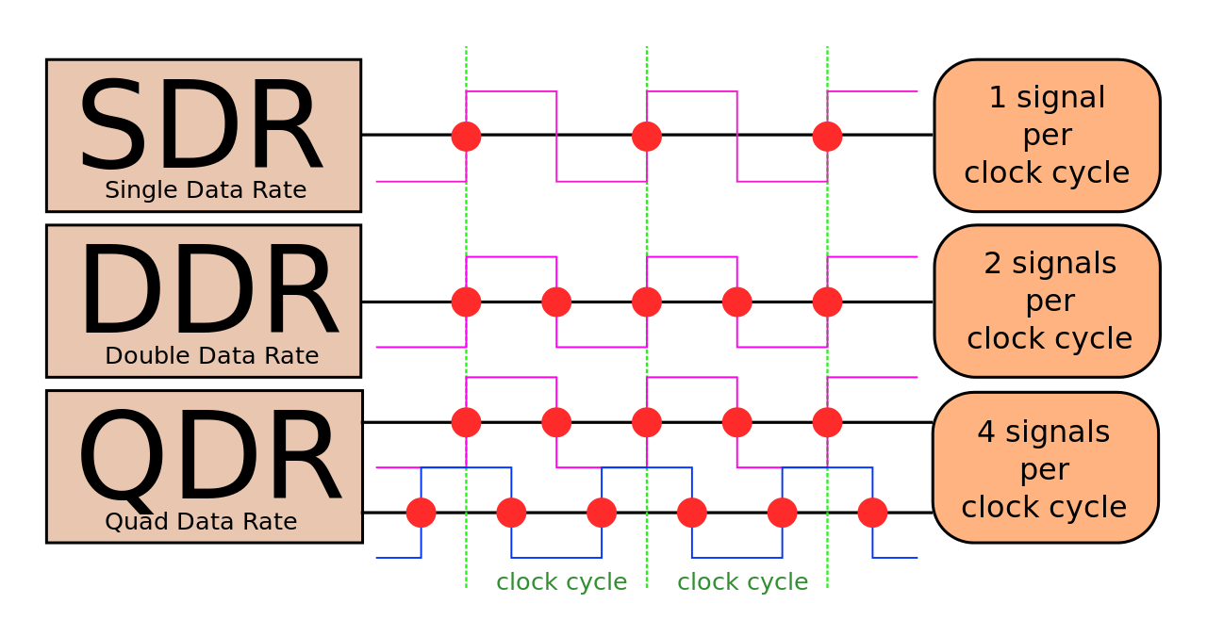
DDR SDRAM
Micron
Hynix
Joint Electron Device Engineering Council
Not backward compatible
Low frequency =>
reduced signal integrity requirements.
Column x Row x Bank x Rank
= DIMM
8chips x 8bit
= 64bits (module)

Slide 2
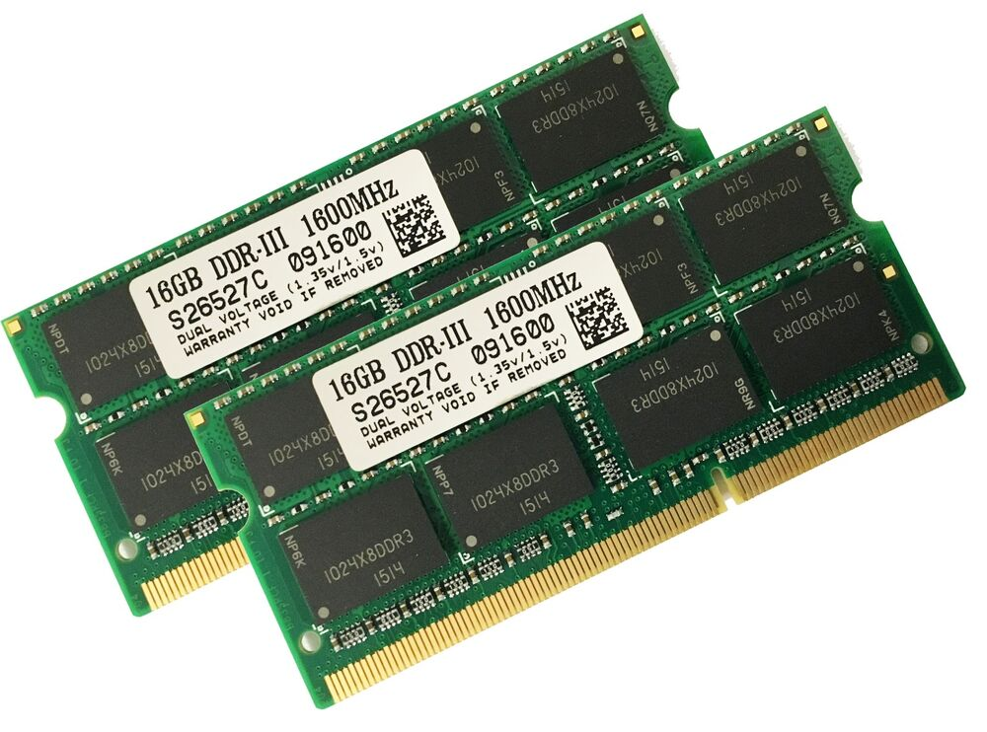
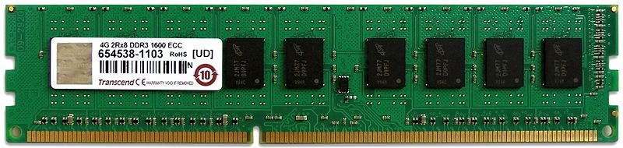
DDR3 SDRAM
Upto 16GB, 1GB/chip, 1.5V (2005)
CL-RCD-RP: col. delay, row delay, prech. delay
BW: mem CK x 4 bus mult. X 2 DDR x 64b
eXtended Memory Profile (XMP, 2007)
DDR3L: 1.35V (2010), DDR3U: 1.25V (2011)
DDR4-800: 100MHz mem CK x 4 = 400MHz IO CK
400MHz x 2 DDR x 64b = 6.4 GB/s (5-5-5)
DDR4-2133: 266MHz mem CK x 4 = 1066MHz IO CK
1066MHz x 2 DDR x 64b = 17 GB/s (11-11-11)
Hynix 16GB: (16 x 1GB) 2133MHz x 64b = 17 GB/s
16GB DDR3 SO-DIMM, 1600 MT/s, 1.35/1.5V
Transcend 4GB ECC DDR3 DRAM, 1600 MT/s (2013)

Slide 3
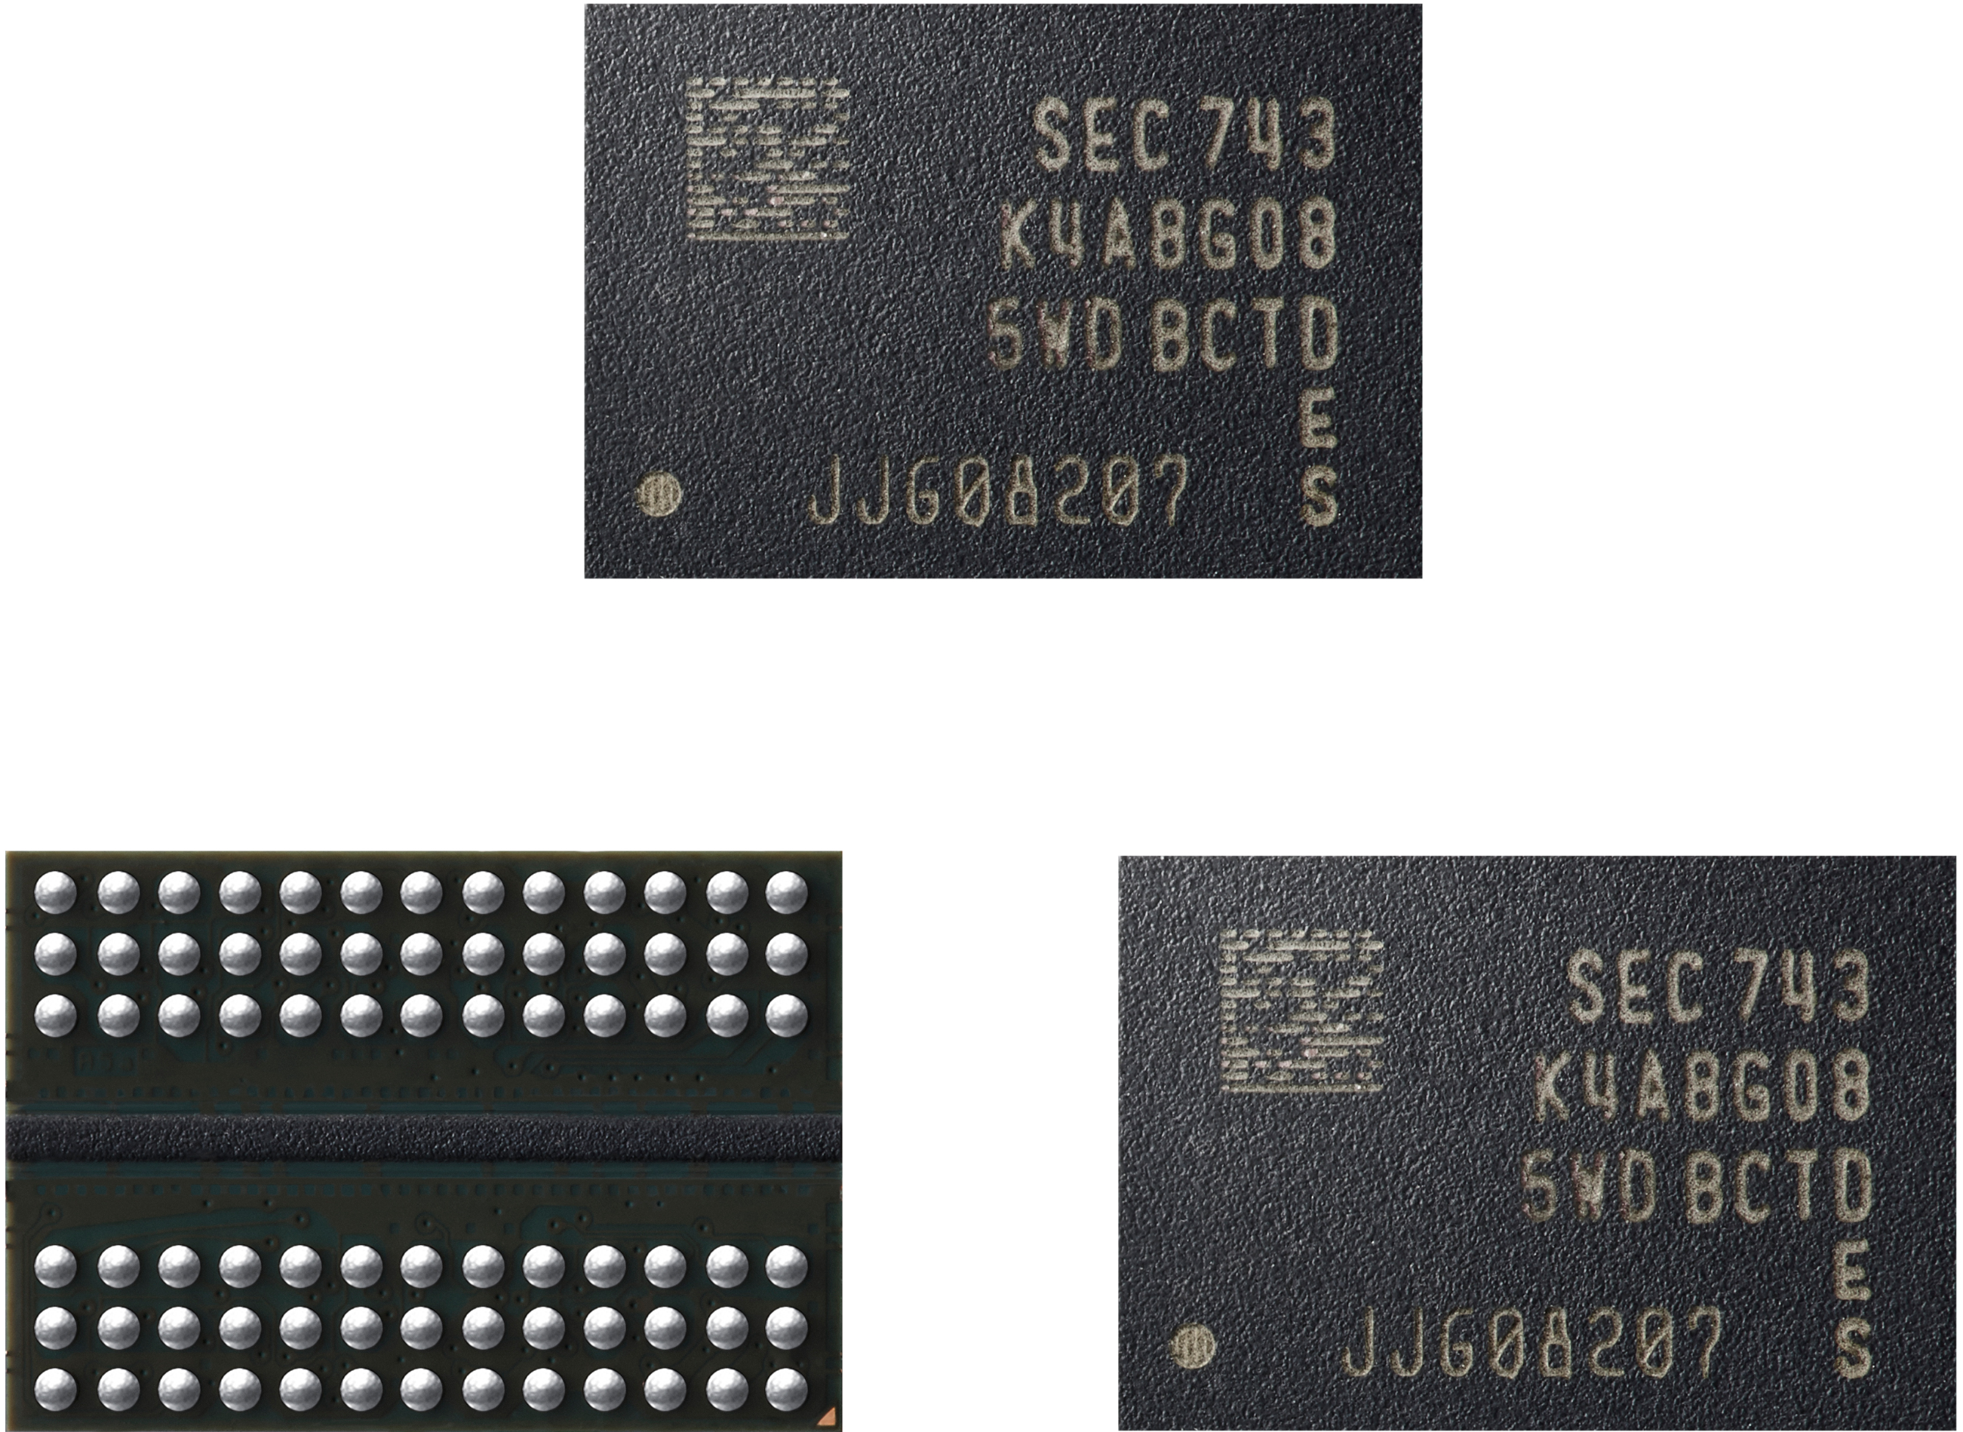
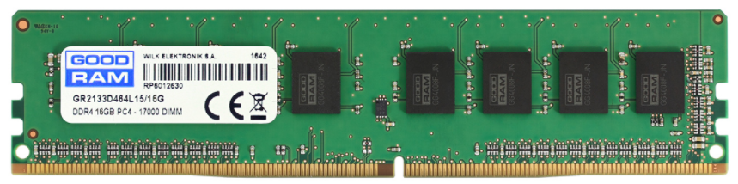
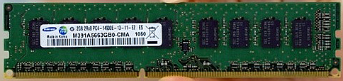
DDR4 SDRAM
Upto 64GB, 1.2V, 40-16nm (2011)
Power: refresh strategies, data bus inv.
Row hammer: large capacitors, ASLR (addr. rnd.)
DIMM: 288 pins, 0.85mm spacink
SO-DIMM: 260 pins, 0.5mm spacing (skylake)
DDR4-1600: 200MHz mem CK x 4 = 800MHz IO CK
800MHz x 2 DDR x 64b = 12.8 GB/s (10-10-10)
DDR4-3200: 400MHz mem CK x 4 = 1600MHz IO CK
1600MHz x 2 DDR x 64b = 25.6 GB/s (20-20-20)
Hynix 16GB: (16 x 1GB) 2133MHz x 64b = 17 GB/s
GOOD RAM 16GB DDR4 DRAM, 2133 MT/s, 1.2V
Samsung 2GB ECC DDR4 DRAM, 2133 MT/s, 1.2V (2011)

Slide 4
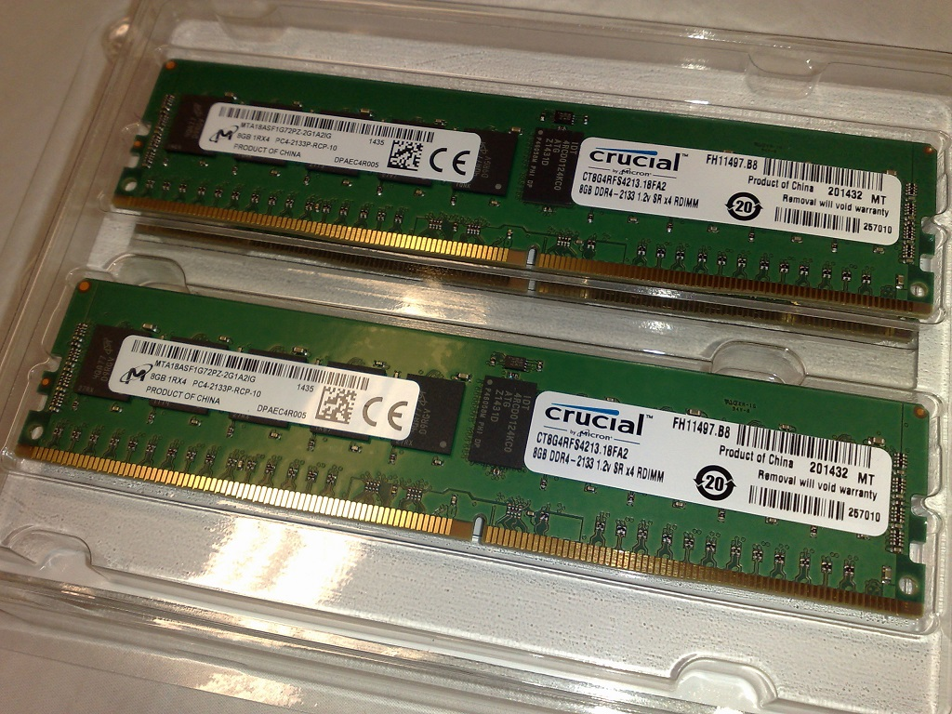
Registered Memory (RDIMM)
For high-density chips (36)
+1 cycle latency
Normally features ECC
Costlier, used in servers
Motherboard must support
RDIMM: +address, +command
LRDIMM: +data (+capacity)
Two 8 GB DDR4-2133 ECC 1.2 V RDIMMs

Slide 5
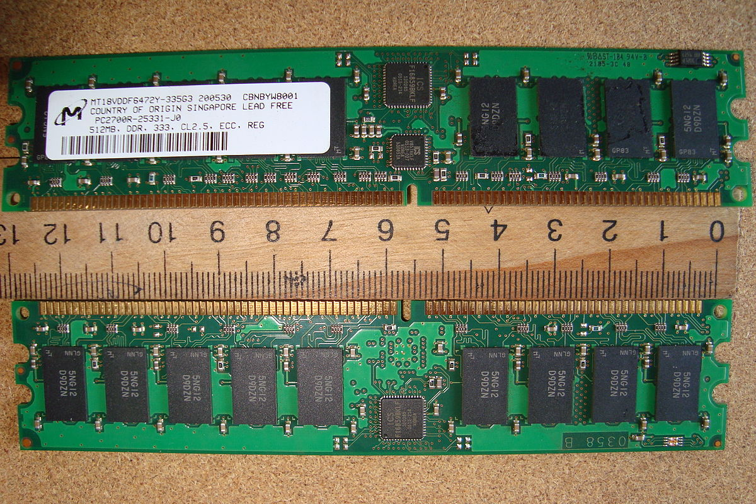
ECC Memory
Immune to 1bit errors (/64bits)
Servers: scientific, finance, L1-L2
Error => crash, data corr., sec.
Row hammer: security exploit
Electrical, magnetic interference
Cosmic secondaries – neutrons
1.5km: 3.5x, 10km: 300x
Cassini-Huygens: =112/Gb/day
Google servers: 1.67/Gb/day
Doesn’t inc. with dec. Size
Hamming code, Chipkill ECC (interleaved)
Non-ECC cant correct errors
ECC DIMMs typically have 9 memory chips on each side

Slide 6
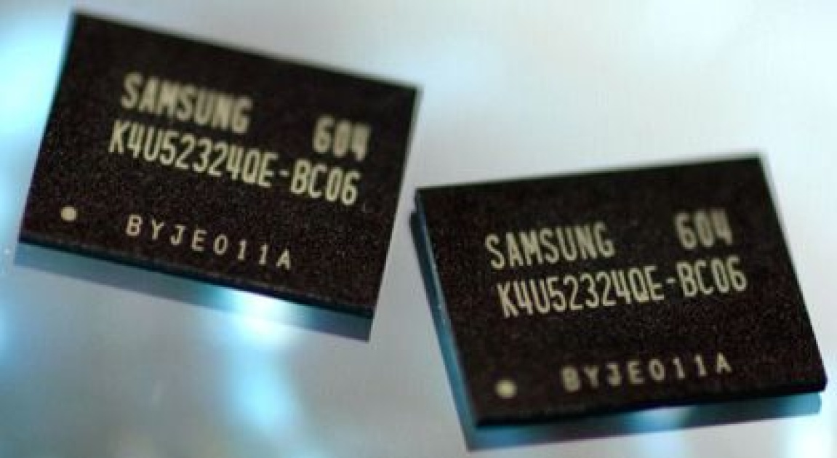
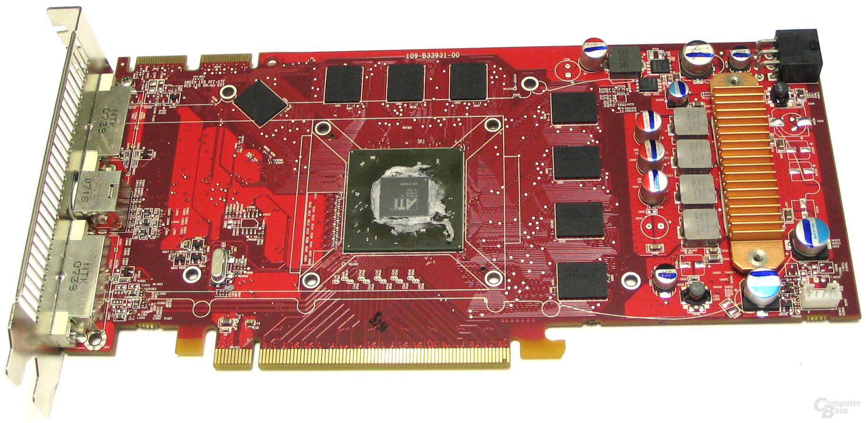
GDDR4 SDRAM
Rival to Rambus XDR DRAM (2005)
GDDR4: Based on DDR3, 32bit, 1.5V
Data Bus Inversion (DBI): -PWR, -GND bounce
2.5 Gb/s x 32bit = 10 GB/s (256Mb, 2005)
4 Gb/s x 32bit = 16 GB/s (512Mb, 2007)
AMD Radeon HD 3870 GDDR4: 512MB, 72 GB/s
1126MHz mem clock x 2 DDR = 2.25 Gb/s
(8 x 512Mb) x 2.25 Gb/s x 32b = 72 GB/s, 256bit
ATi Radeon HD 3870 512MB VRAM, 72 GB/s, 256bit (2007)

Slide 7
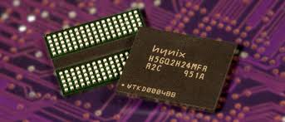
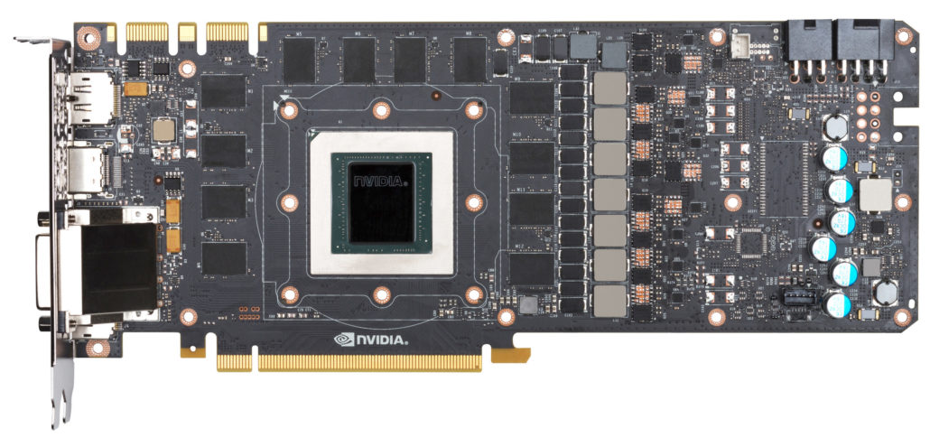
GDDR5 SDRAM
Used in GFX, consoles, HPC (2007)
GDDR5: Based on DDR3, 32bit, 67 signal, 170 BGA
Command CK: 1.25GHz, Data WCK: 2.5GHz (2x)
32b x 2 DDR = 64bit/WCK
32b x 2 DDR x 2 WCK x 2 CK = 256bit (transfer)
GDDR5: 5 Gb/s x 32bit = 20 GB/s (1Gb, 2008)
GDDR5: 8 Gb/s x 32bit = 32 GB/s (8Gb, 2015)
GDDR5X: DDR / Quad Date Rate (QDR), 190 BGA
GDDR5X: 11 Gb/s x 32bit = 44 GB/s (2016)
NVIDIA Titan X GDDR5X: 12GB, 480 GB/s
(12 x 1GB) x 40 GB/s = 480 GB/s, 384bit
NVIDIA Titan X 16nm FinFET, 12GB VRAM, 480 GB/s or 10 Gb/s (2016)

Slide 8
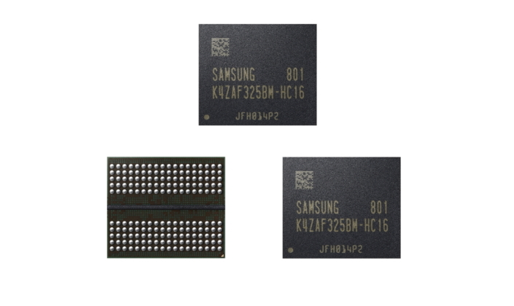
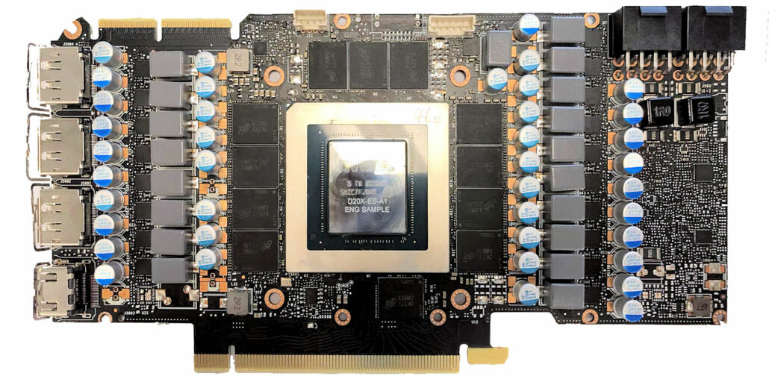
GDDR6 SDRAM
Used in GFX, consoles, HPC (2018)
GDDR6: 18 Gb/s x 32bit = 72 GB/s (2GB, 2018)
GDDR6X: 20 Gb/s x 32bit = 80 GB/s (2020)
GDDR6: Quad Date Rate (QDR), 1.35V
GDDR6X: PAM4, +PHY, -SNR, +BW, -PWR/bit
GDDR6 RAM: 12GB, 768 GB/s
(12 x 1GB) x 72 GB/s = 768 GB/s, 384bit
NVIDIA RTX 3090: 24GB, 19.5 Gb/s
(12 x 2GB) x 19.5 Gb/s x 32b = 936 GB/s, 384b
NVIDIA GeForce RTX 3090, Ampere, 24GB VRAM, 19.5 Gb/s (2016)

Slide 9
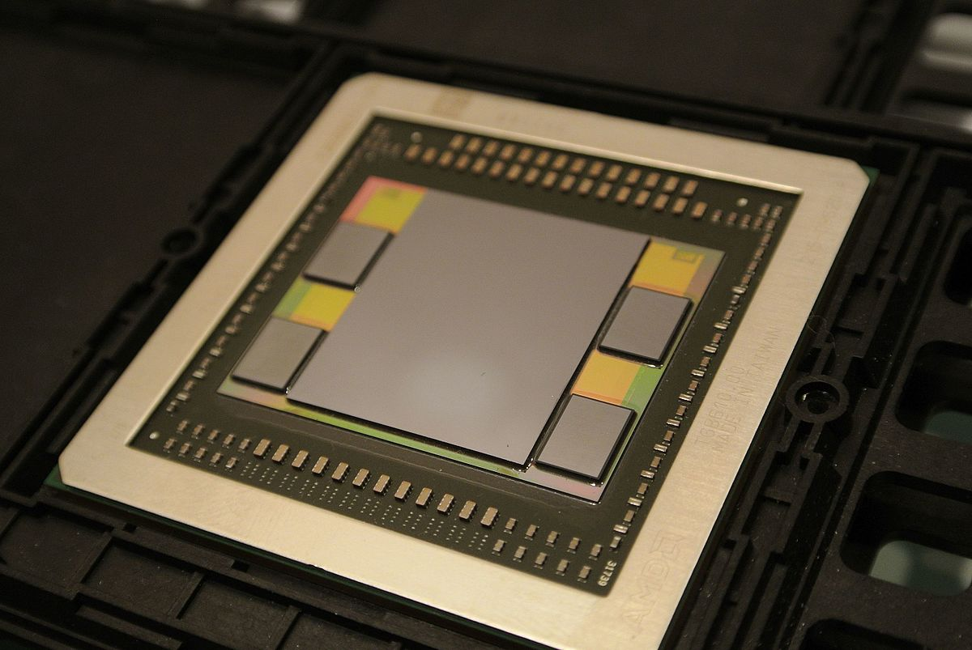
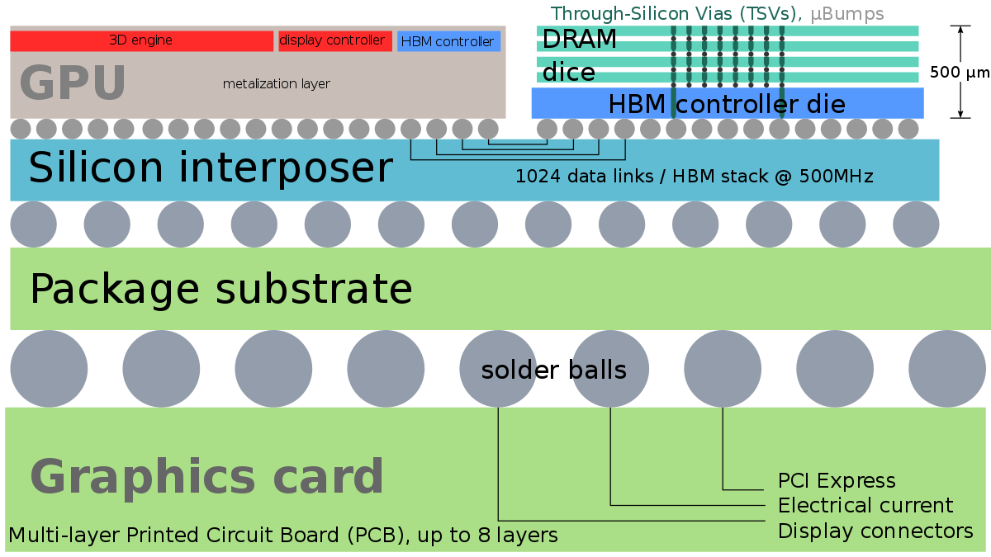
High Bandwidth Memory (HBM)
65nm sillicon interposer, 1.3V
Heat, engineering issues
Costlier than PCB
Used in high BW apps
HBM: AMD Fiji Radeon R9 Fury X (2015)
128bit x 2 channels x 4 dies = 1024bit
500MHz x 2 DDR x 1024b = 128 GB/s (4GB, 2013)
HBM2: Nvidia Tesla P100 (2016)
HBM2: 2 GT/s x 1024b = 256 GB/s (8GB, 2016)
HBM2E: 3.6 GT/s x 1024b = 460 GB/s (16GB, 2019)
(independent channels)
AMD Fiji, the first GPU to use HBM (2015)

Slide 10
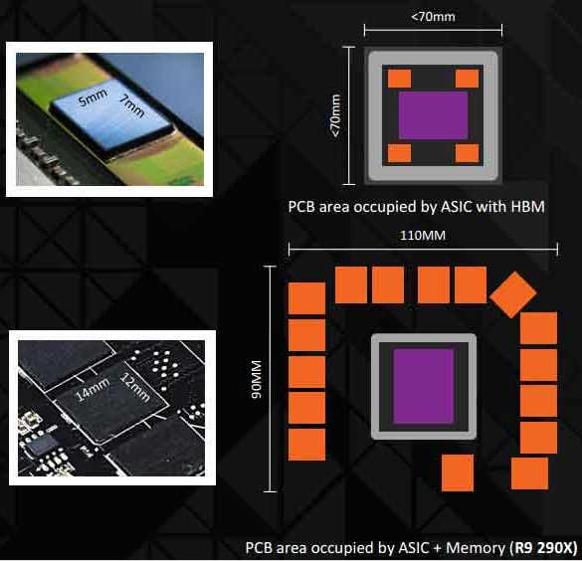
High Bandwidth Memory (HBM)
GDDR5 chips not getting smaller
Large no. of chips needed for high BW
High PCB area needed, complex routing
Higher power needed due to termination
More signal integrity challenges
Larger SoC PHY area needed
HBM ~3x less power requirement than GDDR5
94% less chip area than GDDR5 (=capacity)
50% less PCB area than GDDR5 system
2.5D interposer costly, relatively new

Slide 11
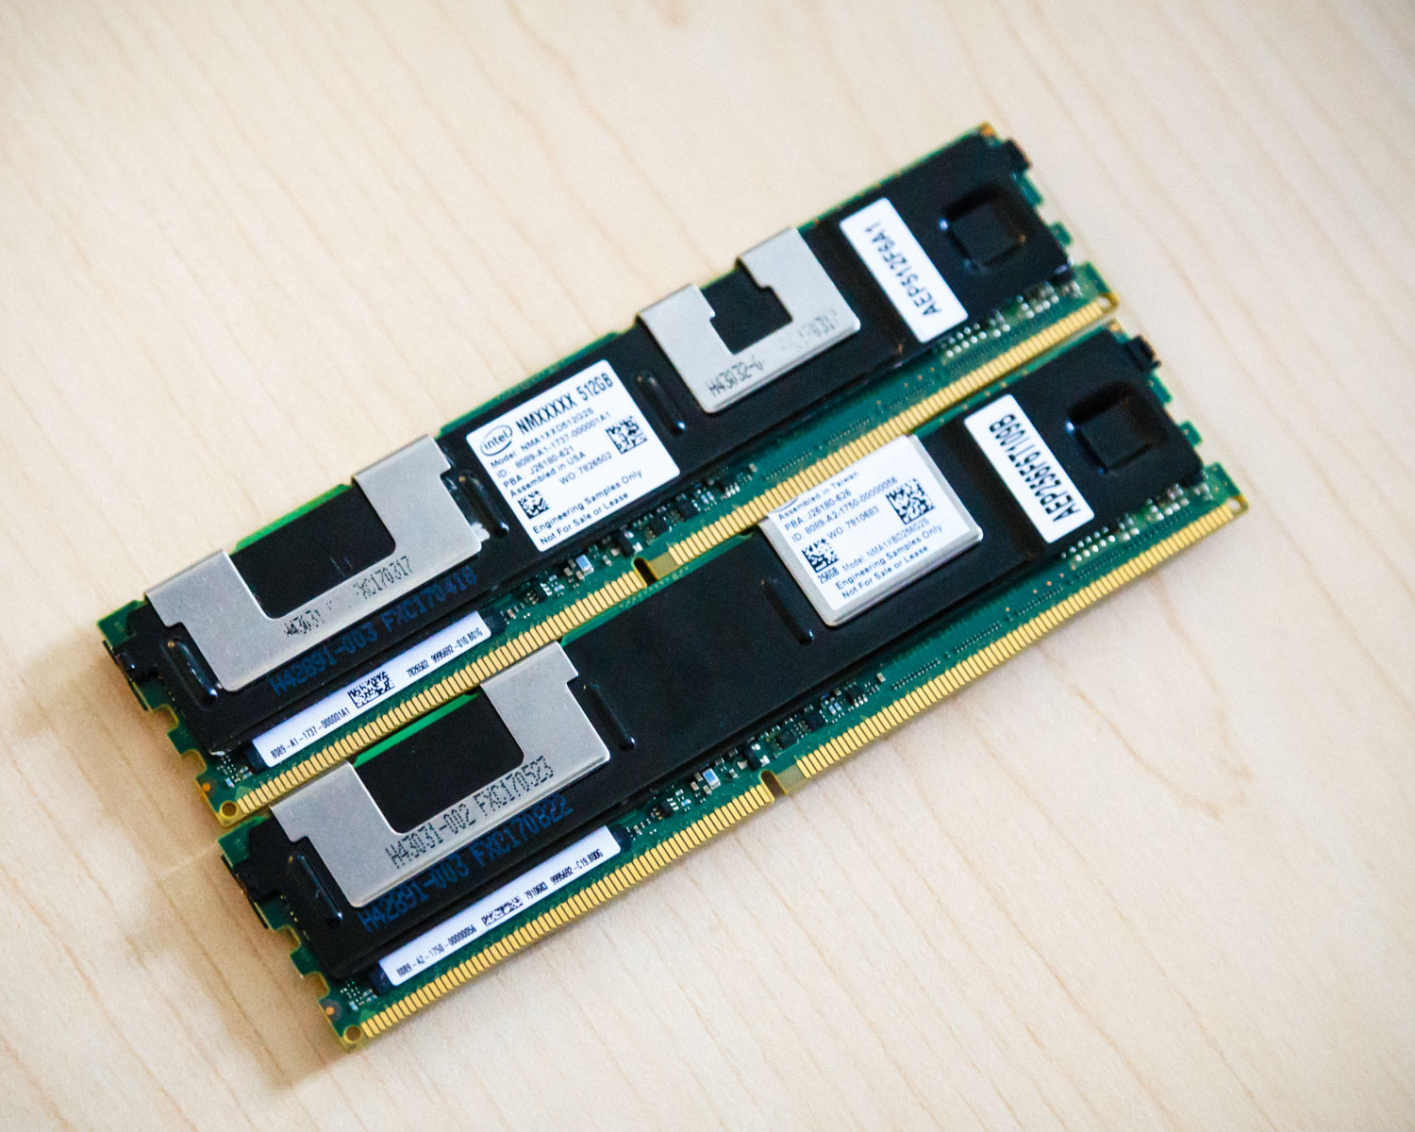
Non-Volatile RAM (NVRAM)
Floating-gate MOSFET
EPROM, EEPROM, EEPROM+SRAM, Flash
Phase-change RAM (PCRAM): 3D XPoint Intel Optane, Micron Quantx
Ferroelectric RAM (FeRAM)
Magnetoresistive RAM (MRAM)
Electrochemical RAM (ECRAM)
Resistive RAM (ReRAM)
Can be fully-powered down
For in-memory analog mat-mul (DNN)
Two Intel Optane 256GB DDR4 DIMMs with AES-256 (2019)

Slide 12
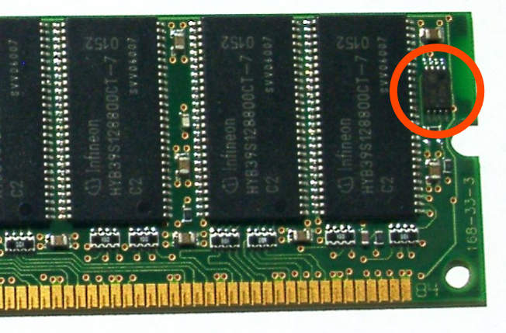
Serial Presence Detect (SPD)
Standardized way to automatically access information about a memory module
What memory timings to use to access the memory
Overclocking: over-ride SPD data
Accessed using SMBus, a variant of the I²C protocol
SMBus: System Monitor - power supply, CPU temp., fan speeds.
XMP uses bytes 176–255, unallocated by JEDEC, to encode higher-performance memory timings.
Memory device on an SDRAM module, containing SPD data

Slide 13
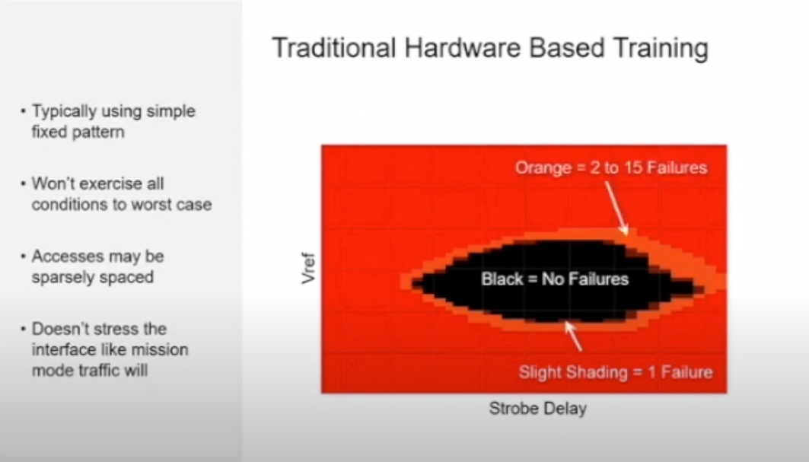
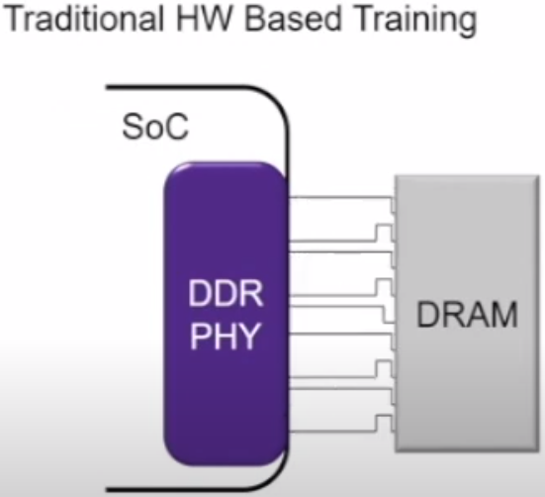
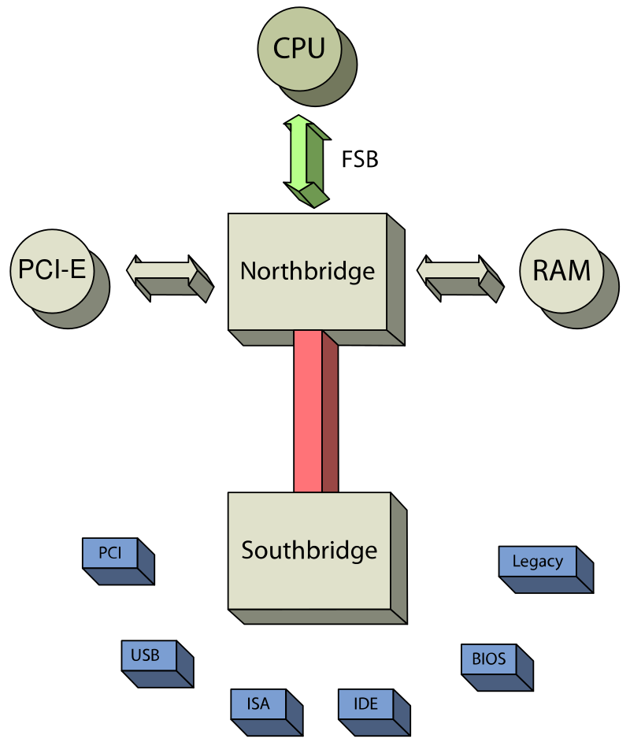
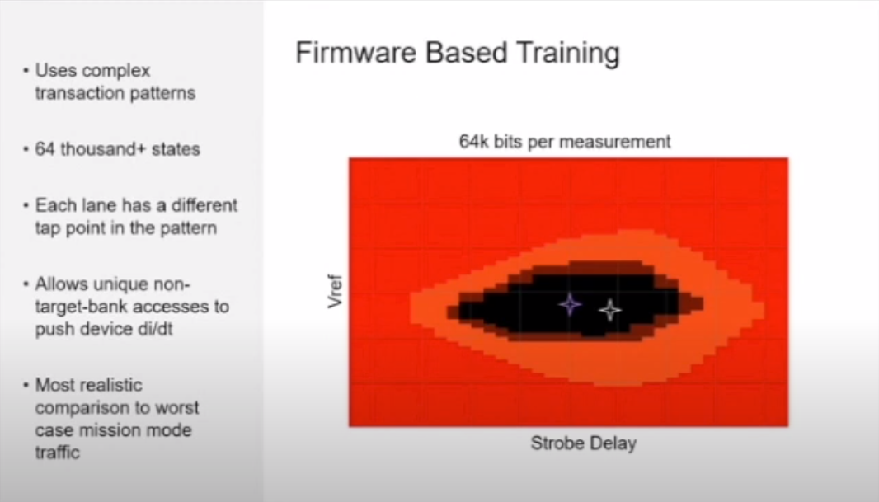
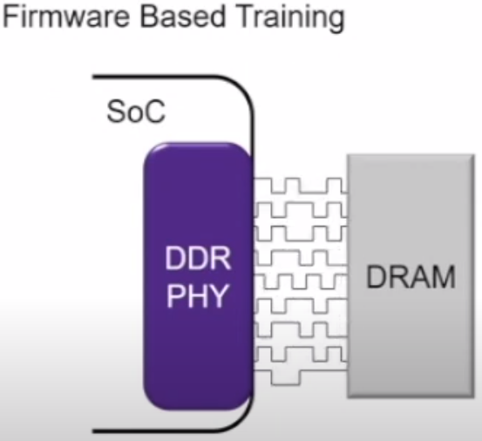
DDR PHY Training

Slide 14
